Slide 1
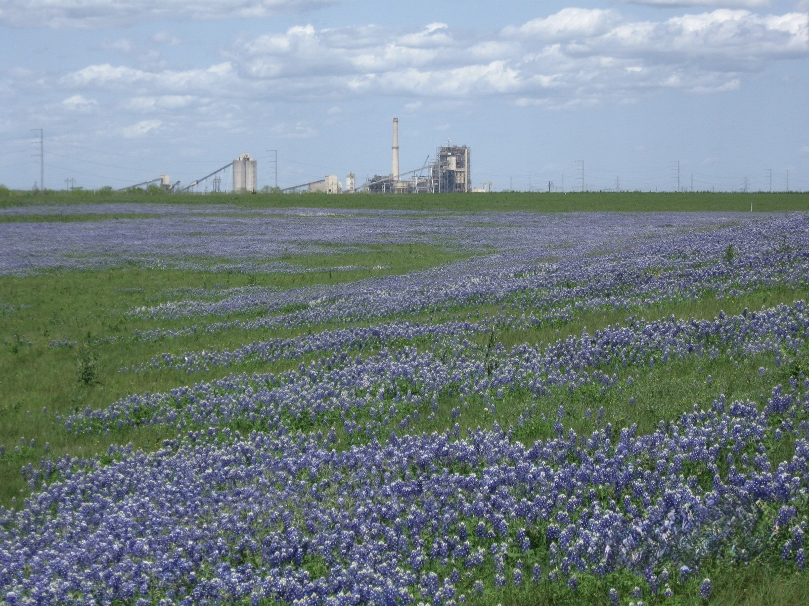

USDA COMMUNITY BENEFITS PLAN
San Miguel Electric Cooperative, Inc.
Notes:
Welcome everyone and thank you for joining us today.

Slide 2

Jason Cowan
Chief Executive Officer & General Manager
San Miguel Electric Cooperative, Inc. (SMECI)
​
San Miguel Electric Cooperative, Inc.
Notes:
I am Jason Cowan, CEO & General Manager of SMECI. (introduce any others who will be joining you. Once you know, I will create a slide for them as well).

Slide 3
Our focus is simple:
Supporting our workforce, strengthening our communities, and building a sustainable energy future that creates opportunity for generations to come.
San Miguel Electric Cooperative, Inc.
Notes:
As we convert our fuel sources at the Cooperative, we know that will mean changes for the community that will include transitions, as well as new opportunities for the workforce and the region.

Slide 4
Today’s Topics
SMECI and USDA’s Empowering Rural American (New ERA) program
Community Benefits Plan (CBP)
Opportunities for Impact
CBP Implementation and Next Steps
​
San Miguel Electric Cooperative, Inc.
Notes:
As part of the “New ERA” program (Empowering Rural America), a CBP (Community Benefits Plan) is a non-binding agreement between a project applicant and key community and labor stakeholders that outlines how the project will benefit residents and address concerns from the host community.

Slide 5
Planned Conversion
San Miguel Electric Cooperative, Inc.
Notes:
The USDA CBP is a strategic tool to ensure that federally funded rural projects deliver real, measurable benefits to the communities they serve, while fostering trust and cooperation between developers and residents.

Slide 6
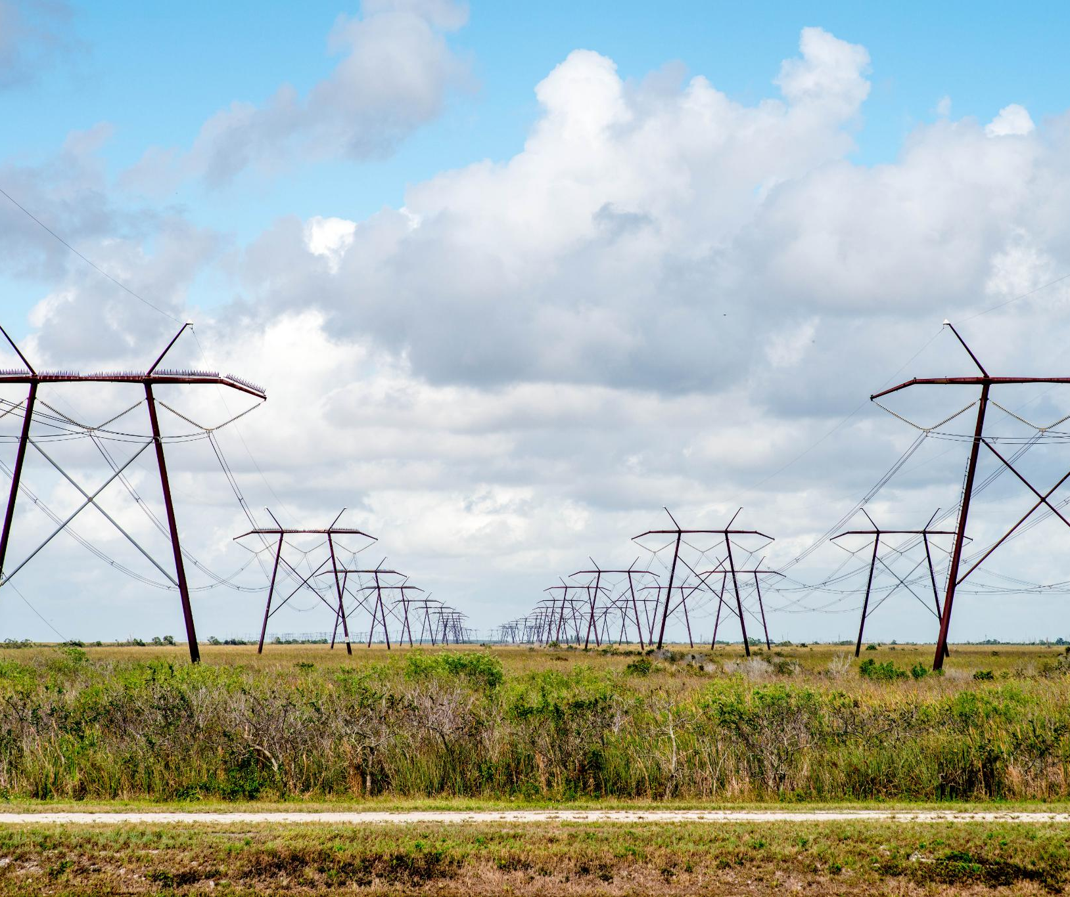
Empowering South Texas Forward
Innovative Energy Solutions
  Cutting-edge energy initiatives promote sustainability and keep South Texas at the forefront of technological progress.
Strategic Partnerships
  Collaboration among businesses, government and organizations fosters long-term growth and positive regional impact.
Community Investment
  Investing in infrastructure, education and jobs strengthens South Texas and empowers future generations.
San Miguel Electric Cooperative, Inc.
Notes:
Why is San Miguel making the conversion?

Slide 7
CBP Goals
Outline tangible benefits
Address potential impacts
Enhance public support
Ensure milestones
San Miguel Electric Cooperative, Inc.

Slide 8
Environmental Stewardship
Black Lace Conservation Program
Texas Horned Lizard Reintroduction Project
Native Plant Restoration and Pollinator and Habitat Program
San Miguel Electric Cooperative, Inc.
Notes:
As part of the program, we have reviewed established environmental support programs and identified opportunities for growth. These well-established programs are ones that deliver great benefit to the community and environment in South Texas.

Slide 9
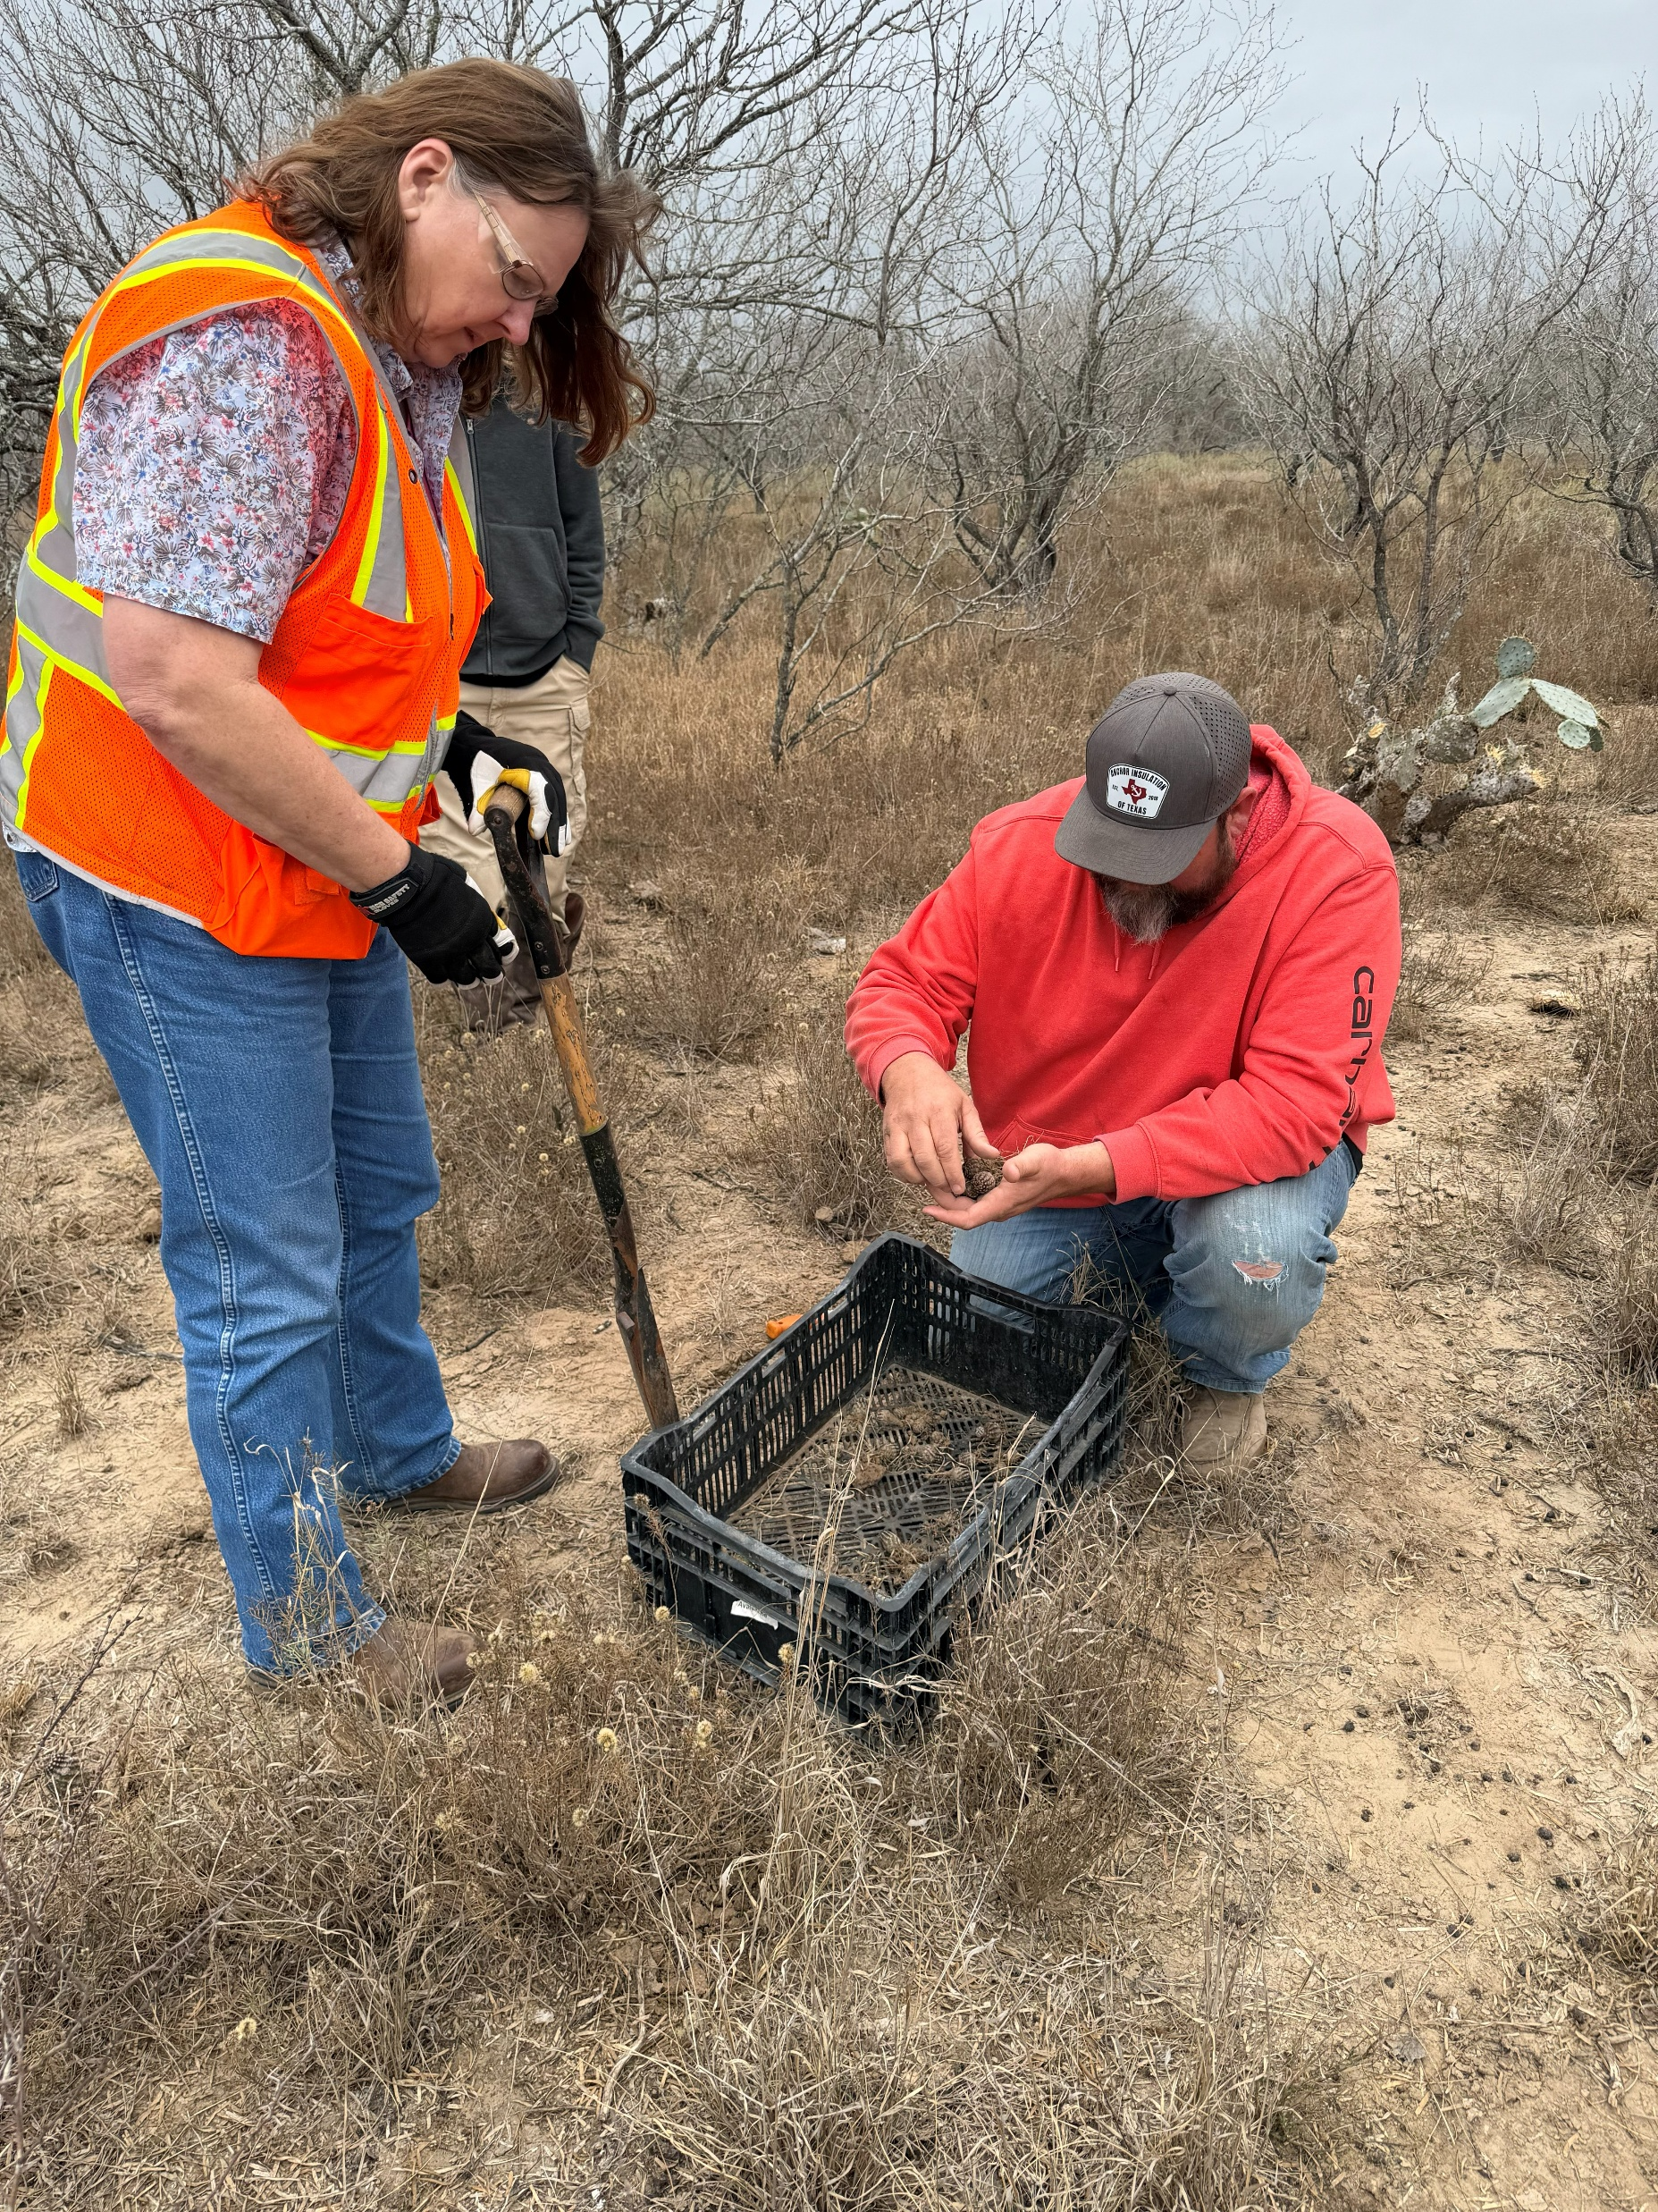
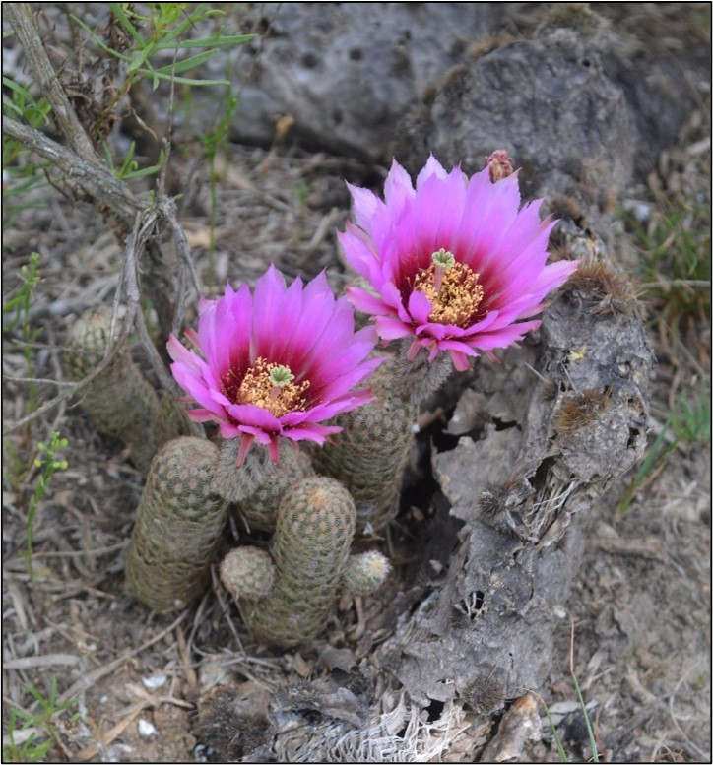
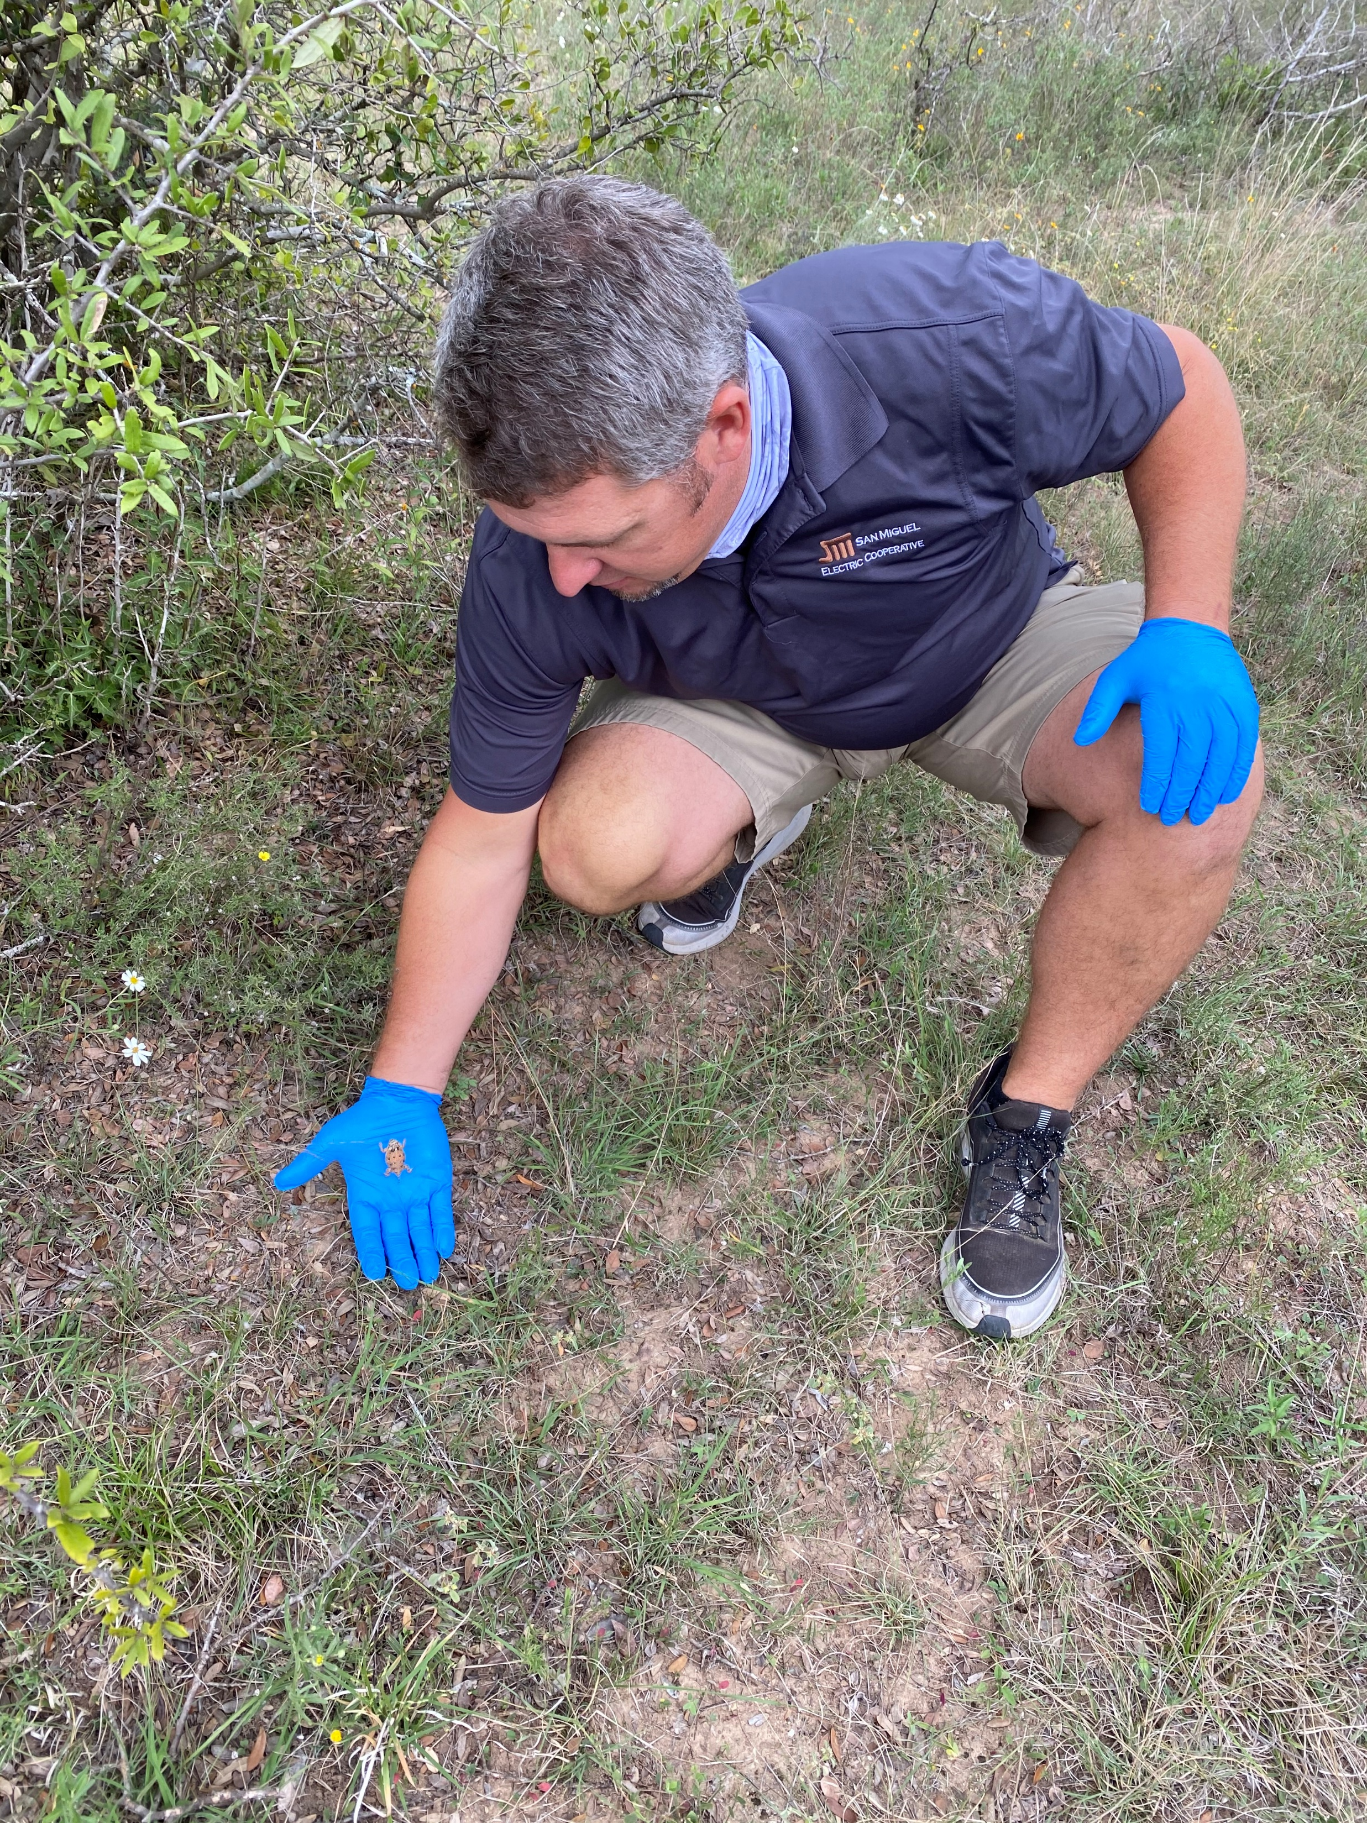
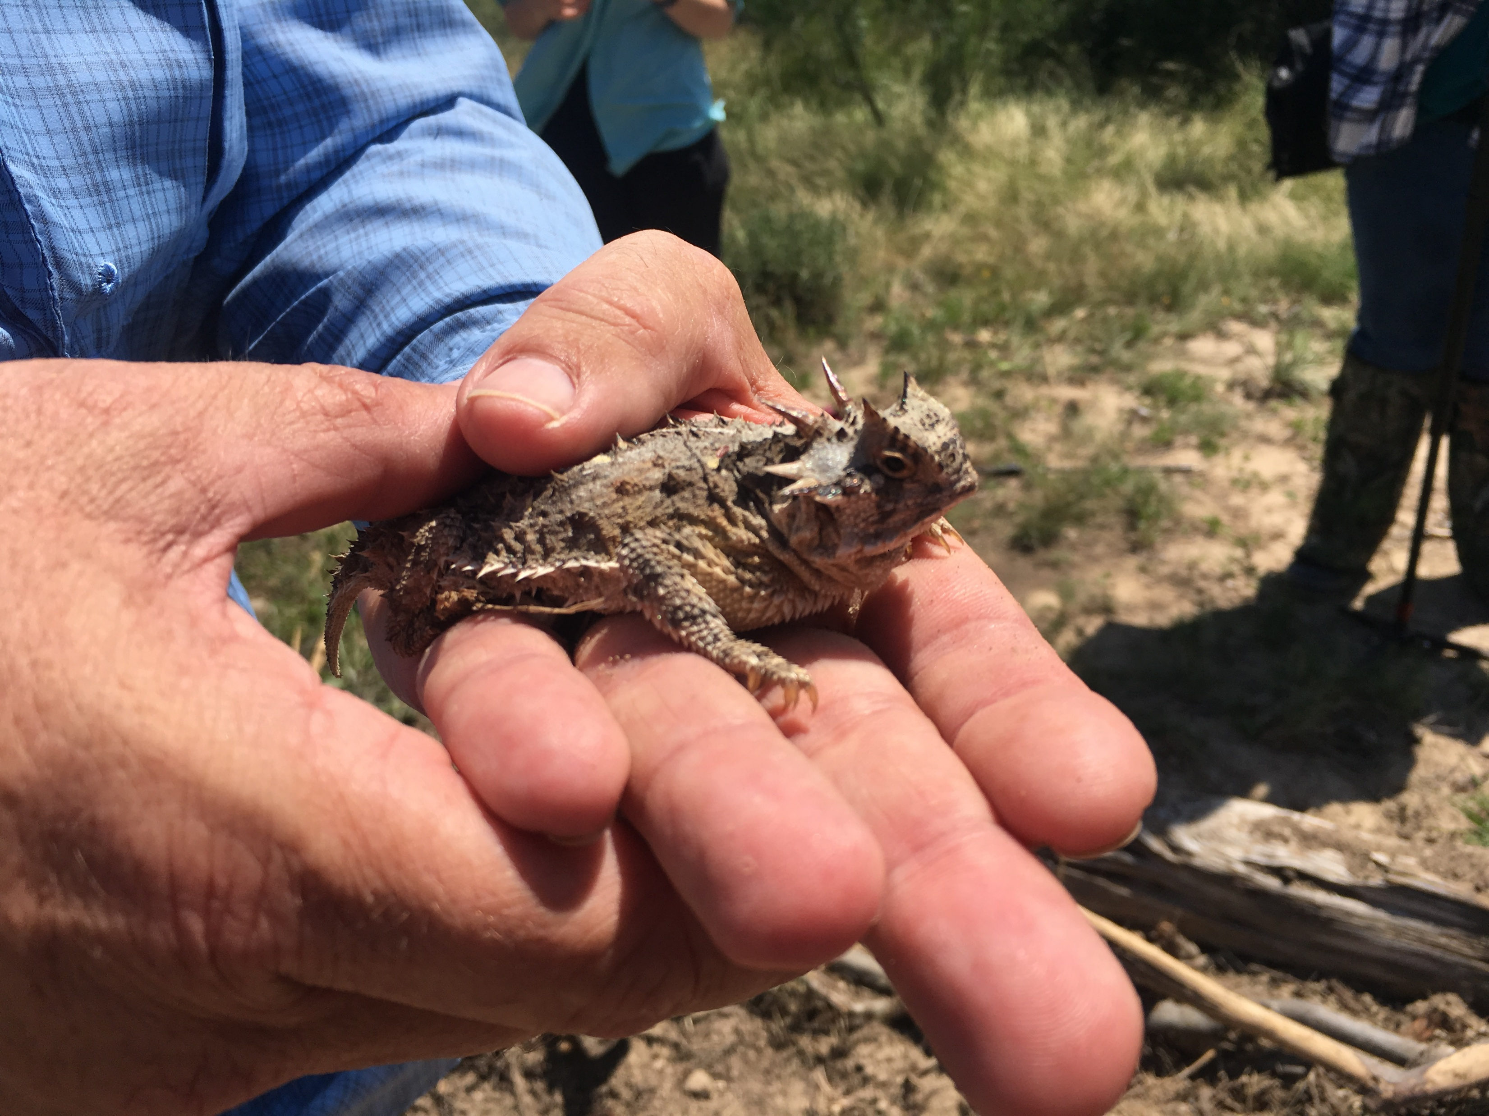
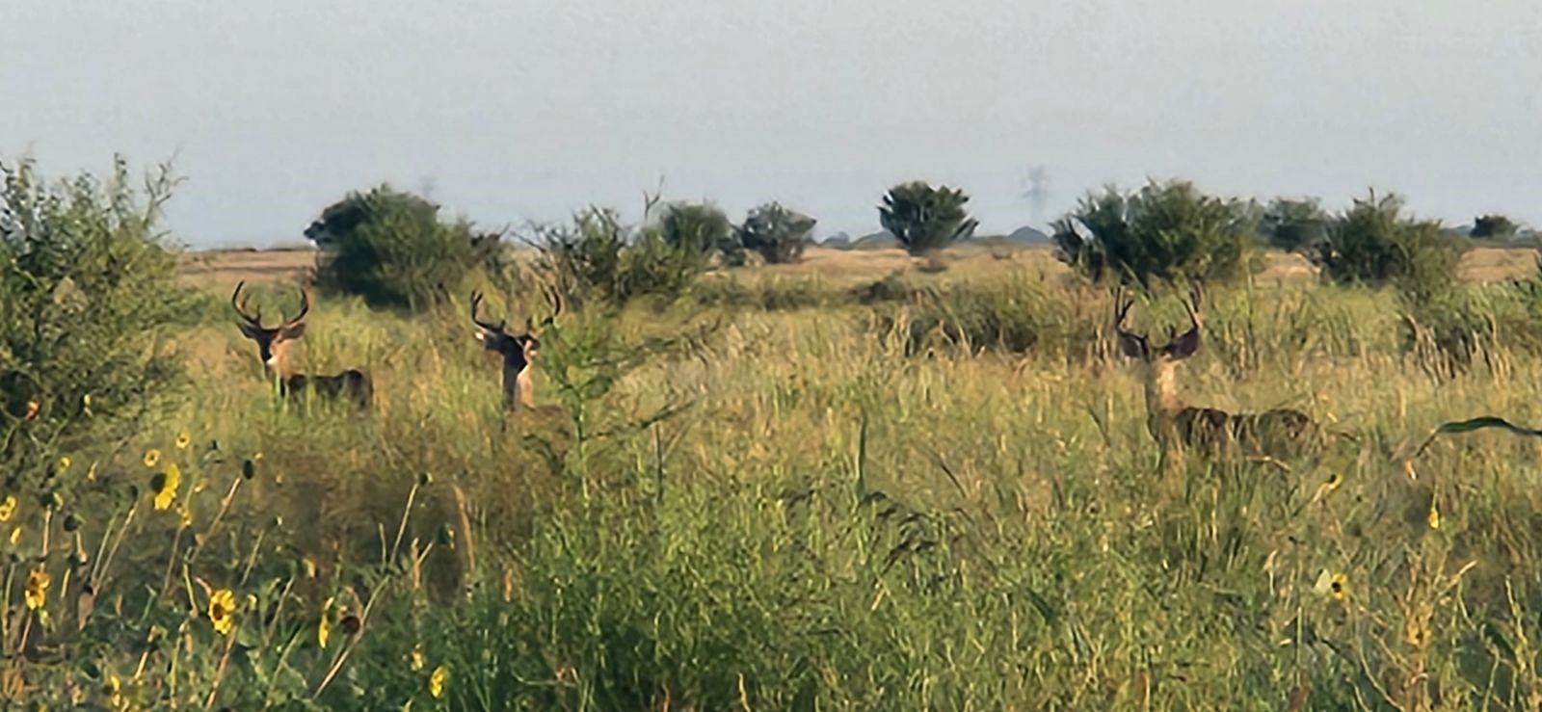
San Miguel Electric Cooperative, Inc.
Notes:
We support the San Antonio Zoo’s horned lizard reintroduction program to return these beloved toads to their natural habitat. Here at San Miguel, our black lace program was just showcased by Texas Monthly magazine. It may represent the largest translocation of endangered cacti in Texas history. Our goal is to establish a replicable model for future efforts, while also developing a reliable source of propagated plants to support similar restoration initiatives across the species’ range. All the while, we are committed to reintroducing native species to the land post-reclamation.

Slide 10
Community Investment
Texas Mining & Reclamation Association Teacher Workshop Program
Jamie’s Ranch for Special Kids Partnership
Annual charitable contributions to local charities who help those in need
San Miguel Electric Cooperative, Inc.
Notes:
For many years, the Cooperative has dedicated itself to a great variety of worthy educational and charitable programs that benefit South Texans.

Slide 11
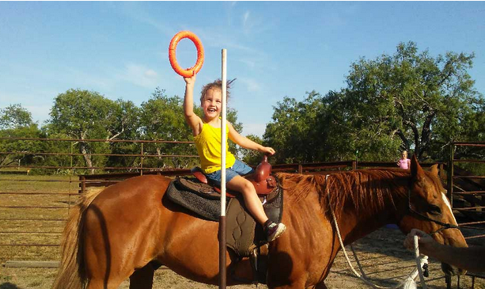
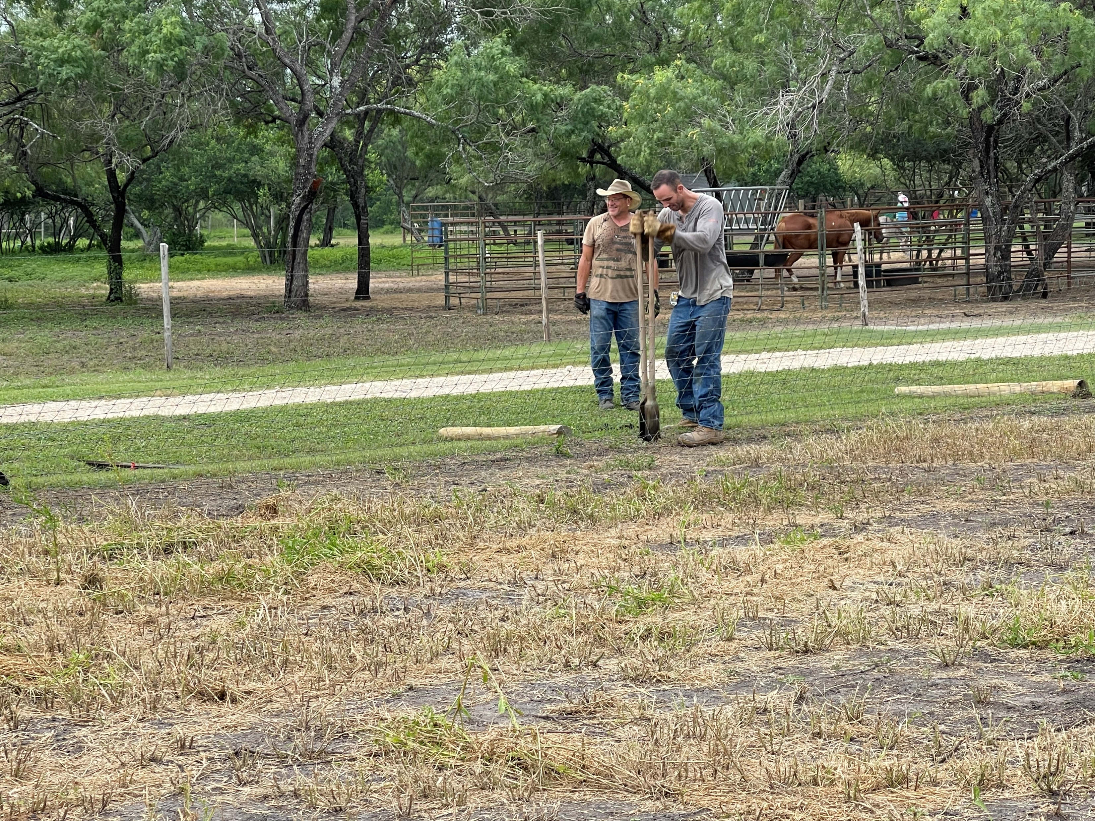
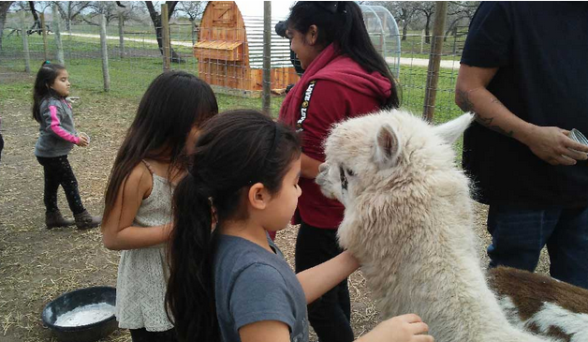
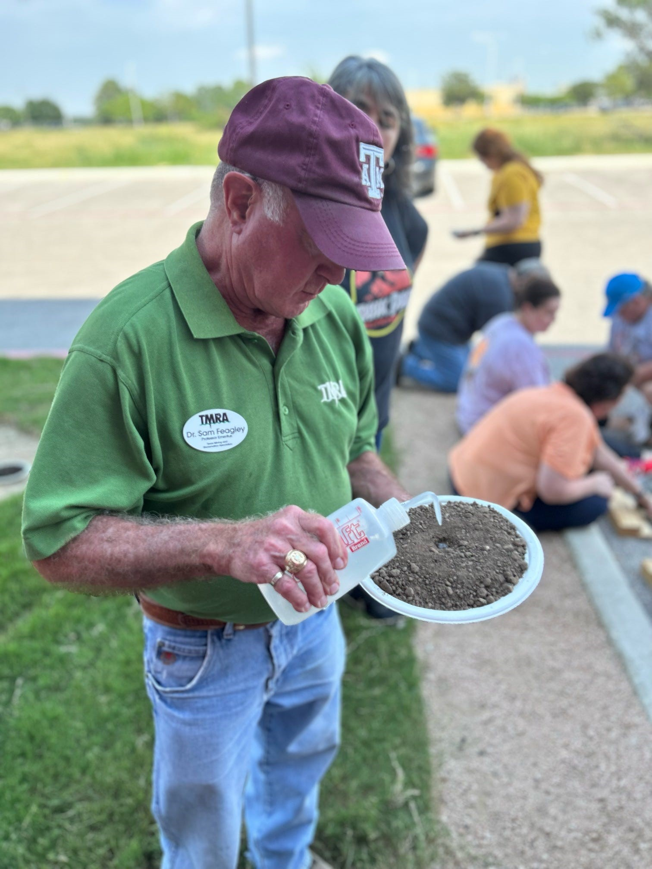
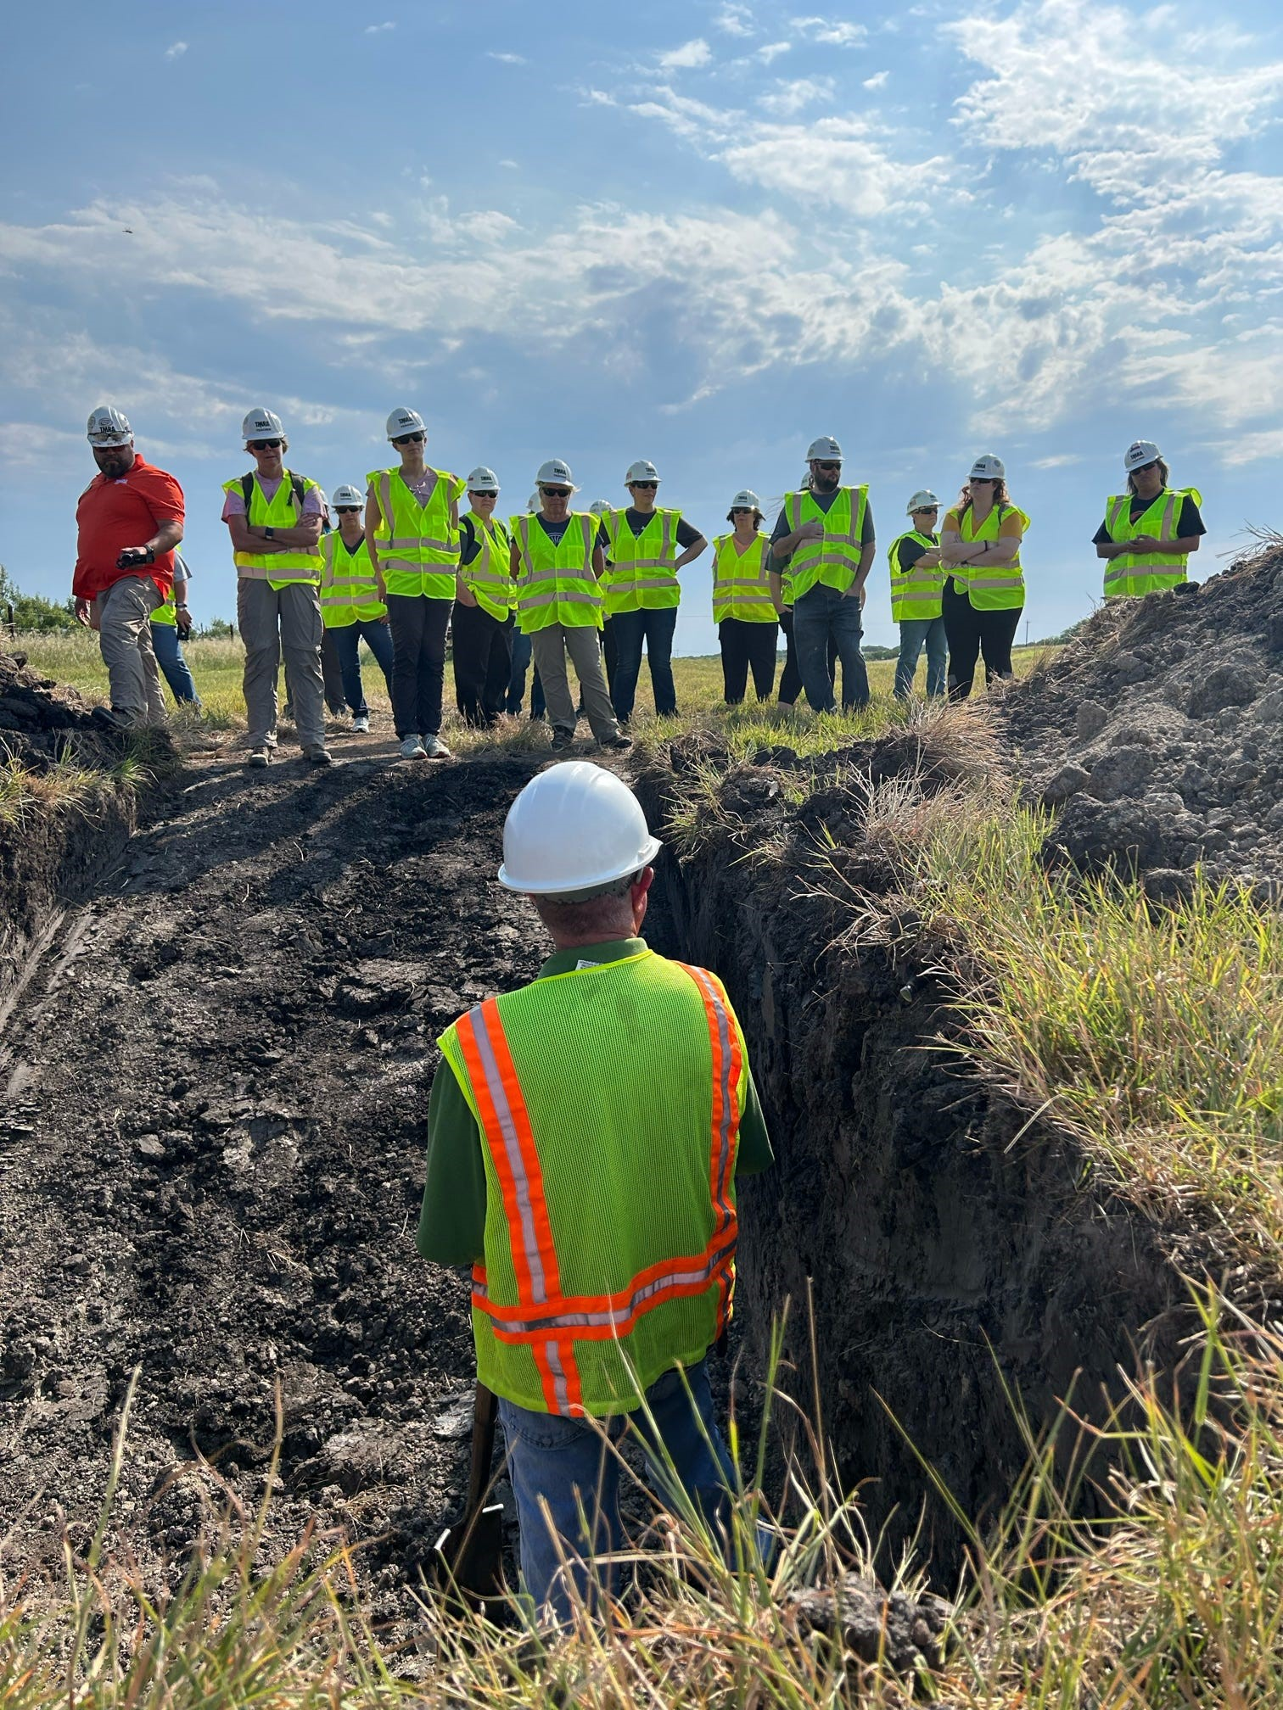
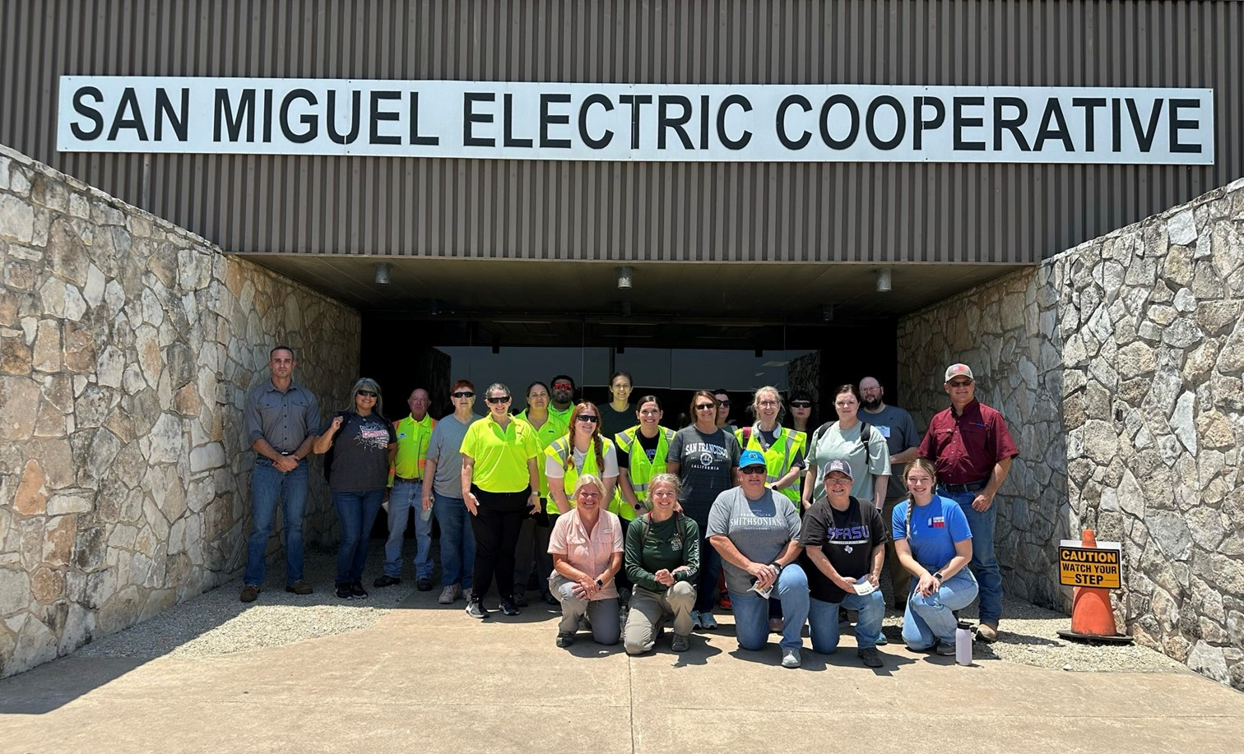
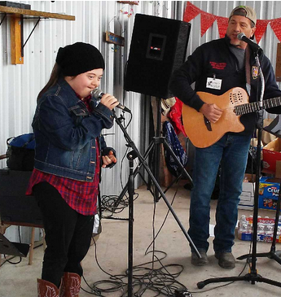
San Miguel Electric Cooperative, Inc.
Notes:
San Miguel makes monetary contributions to area charities and educational programs, as well as donating hundreds of volunteer hours to worthy programs to include Jamie’s Ranch, as well as the TMRA Teacher Workshops, where more than one million teachers and students have heard the true story of Texas mining.

Slide 12
Workforce Transition
SMECI working with regional workforce training organizations
Build upon existing or create new pathways for our workforce
San Miguel Electric Cooperative, Inc.
Notes:
SMECI is working with regional workforce training organizations to build upon existing, or create new, career pathways for members of the workforce who may be impacted by evolving power generation plans.

Slide 13
Opportunities Include
Career navigation and support services through Workforce Solutions and other partnerships
San Miguel Electric Cooperative, Inc.
Notes:
We recognize that this transition will bring changes for our workforce, and we do not take that lightly. We are committed to working with employees, educational institutions, workforce organizations and community partners to provide training and transition assistance that helps workers pursue new opportunities in the evolving energy economy.

Slide 14
Timeline
We continue to advance the planned transition from lignite-based generation to solar and battery power
The Cooperative is working closely with the U.S. Department of Agriculture to finalize the underwriting process, of which the CBP is a part
Once complete, San Miguel will be able to establish a more definitive timeline
San Miguel Electric Cooperative, Inc.

Slide 15
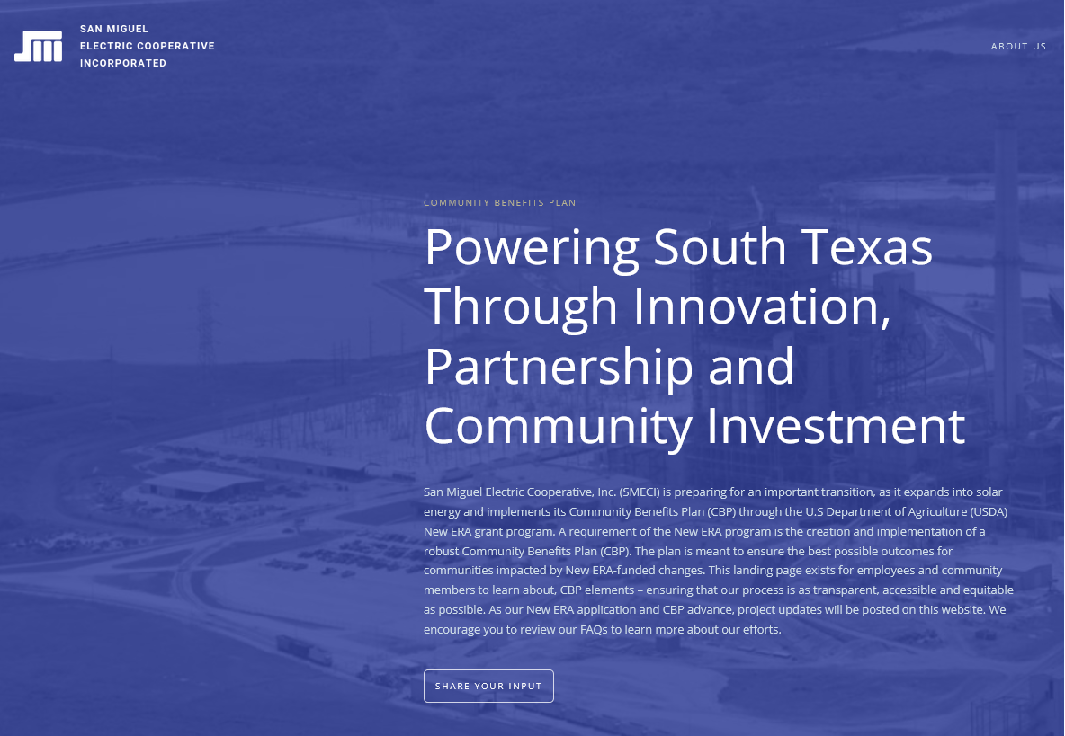

Learn more on the SMECI website
San Miguel Electric Cooperative, Inc.
Notes:
We have created a page on our website that will allow you to share your support and any thoughts you may have. There you will find Frequently Asked Questions, as well as a Share Your Input button.

Slide 16
Thank you for your time
San Miguel Electric Cooperative, Inc.
Notes:
We believe this transition will bring many challenges AND opportunities to South Texas. Thank you for joining us today.

